Slide 1
HEART DISEASE PREDICTION USING MACHINE LEARNING
Presented By: B.Keerthiga – III Year, K.V.C.E.T
NM ID: au421221243020
Email ID: keerthiga61003@gmail.com

Slide 2
TABLE OF CONTENTS:
Introduction
Problem Statement
Data Collection
Technology Used
Library Used
Output

Slide 3
INTRODUCTION:
Heart Disease Predictor is an offline platform that utilizes machine learning to analyze patient data and predict health conditions.
Its primary objective is to identify patients at risk and promptly notify medical staff in emergency situations.
By leveraging a comprehensive dataset, the platform can generate accurate predictions and present them through various graphical interfaces.
The results obtained from the predictive models will be critically evaluated to assess their scope and effectiveness.

Slide 4
PROBLEM STATEMENT:
Machine learning has become an essential tool in the healthcare industry, enabling healthcare providers to make better decisions regarding disease diagnosis.
By analyzing historical and real-time data, machine learning models can predict the occurrence of diseases, thus aiding in disease control and maintaining good health.
These models also assist doctors by providing vital statistics, real-time data, and advanced analytics on patients' diseases, lab test results, blood pressure, family history, and clinical trial data.
Overall, machine learning algorithms offer valuable insights to healthcare service providers, supporting improved patient care.

Slide 5
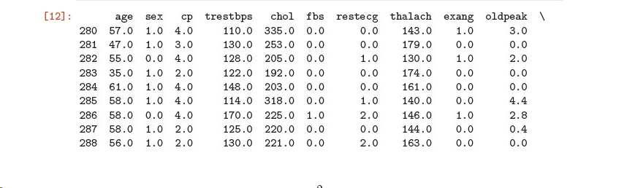
DATA COLLECTION:
Data collection is the process of gathering and measuring information from countless different sources. In order to use the data we collect to develop practical artificial intelligence (AI) and machine learning solutions, it must be collected and stored in a way that makes sense for the business problem at hand.
Data has to be collected from KAGGLE.

Slide 6
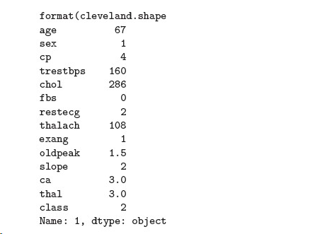
Attributes Used:
Age
Sex
Chest Pain (CP)
Blood Pressure
Cholestrol (Chol)
Fasting Blood Sugar (fbs)
Heart Rate (Thalach)

Slide 7
TESTING TECHNOLOGIES:
Anaconda Python)
Anaconda is a free and open-source distribution of the Python and R programming languages for scientific computing, that aims to simplify package management and deployment.
Jupyter Notebook
The Jupyter Notebook is an open-source web application that allows you to create and share documents that contain live code, equations, visualizations and narrative text. Uses include: data cleaning and transformation, numerical simulation, statistical modeling, data visualization, machine learning, and much more.

Slide 8
LIBRARIES USED:
Pandas
Matplotlib
NumPy
Scikit learn
Keras
Sklearn

Slide 9
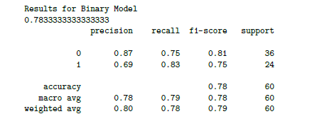
OUTPUT:

